Slide 1

Do you know where your secrets are?
Exploring the problem of secret sprawl and secret management maturity

Slide 2
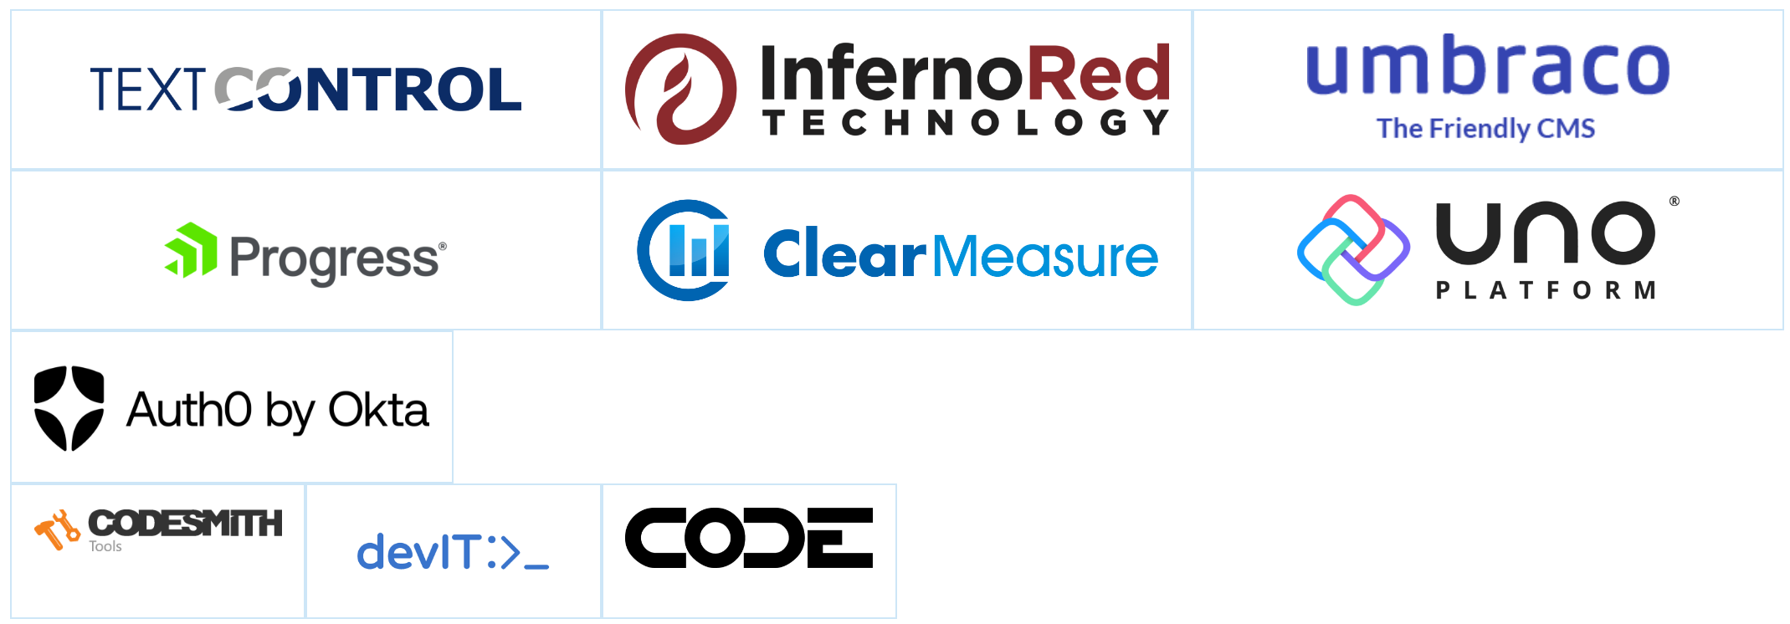
Thank you TechBash 2023 Sponsors!

Slide 3



Hi, I’m Dwayne
I live in Chicago
Co Host - The Security Repo Podcast
I’ve been a Developer Advocate since 2016
On Twitter @mcdwayne
mcdwayne@mastodon.social
Happy to chat about anything, hit me up
Outside of tech, I love improv, karaoke and going to rock and roll shows!
Dwayne McDaniel

Slide 4

About GitGuardian
GitGuardian is the code security platform for the DevOps generation.
—
We help enterprises answer the questions "Where are my hardcoded secrets and have they been leaked?"

Slide 5
Don't Let Your Credentials Leak

Slide 6
The End

Slide 7

“I must not fear. Fear is the mind-killer. Fear is the little-death that brings total obliteration. I will face my fear. I will permit it to pass over me and through me. And when it has gone past I will turn the inner eye to see its path. Where the fear has gone there will be nothing. Only I will remain.”
― Frank Herbert, Dune
Bene Gesserit Litany Against Fear
Notes:
Source: Wiki media

Slide 8

Uber Breach – September 2022
Credential access
2FA/MFA spamming
Uber Internal Network
One exposed secret leads to many others!
Some mistakes are more expensive than others. One hardcoded secret giving access to Uber’s PAM solution led to a an organization wide IT takeover…
Initial access
VPN Access
Scanning
Uber’s Infra
Discovery
PowerShell scripts in network share
PowerShell script contained hardcoded credentials
Privilege escalation
Access to internal apps
AWS, GCP, Google Drive, Slack, SentinelOne, HackerOne admin console, Internal employee dashboards…
Admin access to
Thycotic PAM
Lateral movement

Slide 9

CircleCI – January 2023
Use of a honeytoken alerted the security team of the breach
Remote Engineer
Development System
Attacker
Customer secrets stolen, unauthorised access to GitHub repos and third-party systems
Embedded Malware Used To Steal Secrets
GitHub
CircleCI Platform
CircleCI Internal Network
Hardcoded AWS, GCP, Google Drive, Internal employee dashboards, unencrypted customer data …
Hardcoded AWS, GCP, Google Drive, Internal employee dashboards, unencrypted customer data …
Hardcoded AWS, GCP, Google Drive, Internal employee dashboards, unencrypted customer data …
Customer Application
Customer Application
Customer Application

Slide 10

Toyota – October 2022
Found by a third party security researcher
Toyota
Subcontractor
Private T-Connect repo, that included a key to production data server, cloned and pushed to a public GitHub repo. This exposed data of 296,000 customers for 5 years.
Private GitHub
Repo
Public GitHub Repo
Publicly Accessible
Data Server Key
Data Server Key
Customer Data Server

Slide 11

AstraZeneca – November 2022
Unknown number of affected end users
Developer 2
Developer 1
Test environment credentials pushed to GitHub. Another user pushed real patient data to the test environment.
Credentials were exposed for over a year before reported. Number of patients affected was never disclosed.
Test Env Credentials
Patient Data
Publicly Accessible
Public
GitHub
Repo
Test Env

Slide 12
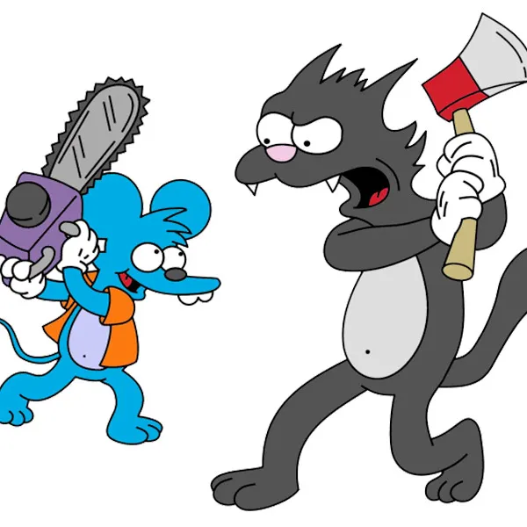



Slide 13

"These hackers aren't kids on a digital joyride, ... It's clear their motive is financial gain."
- Alfred Huger
Creator of CyberCop Sting
First Commercial Honeypot
Notes:
https://www.linkedin.com/in/alhuger/?originalSubdomain=ca

Slide 14
What Attackers Want:
Machine Resources
Access To Data
Anything That Leads To 1 or 2

Slide 15
Credential Leakage Is
A Growing Problem

Slide 16
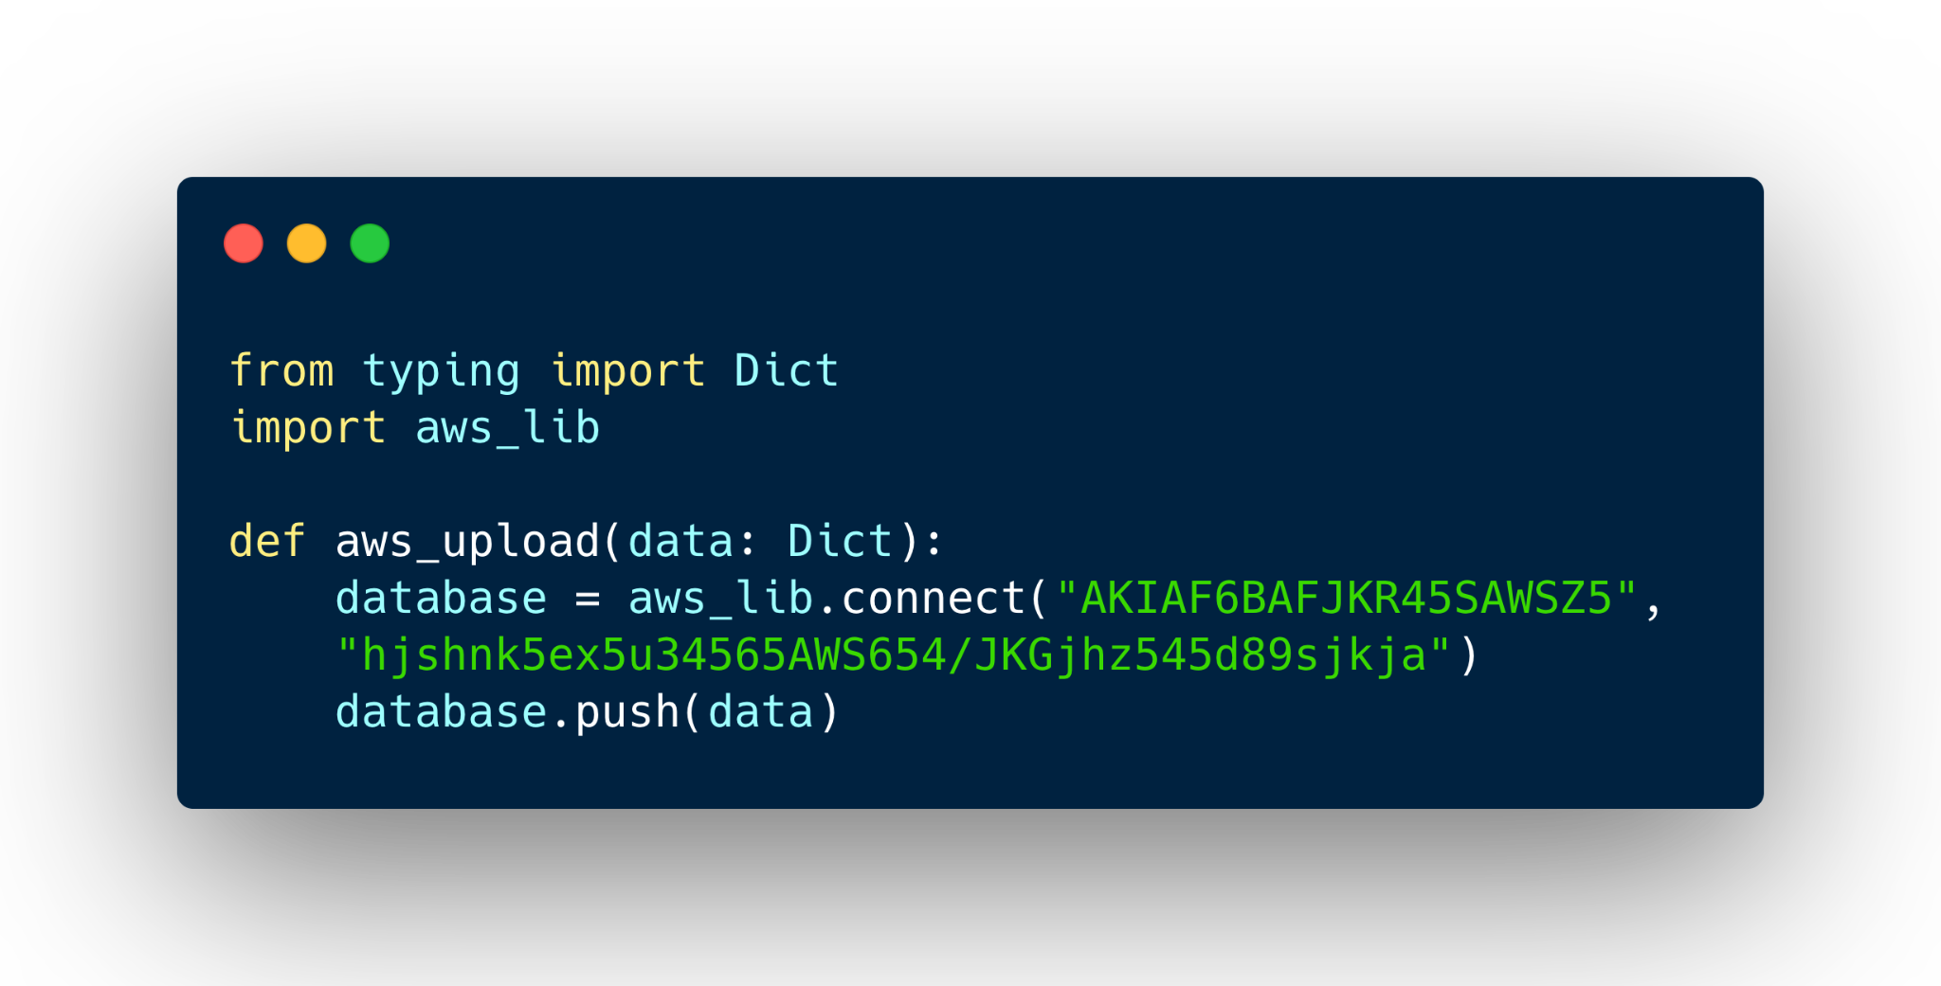
What are secrets in software development?
Definition
—
Secrets authenticate access and encryption of software components, such as:
API keys
Username/password pairs
Database connection URLs
Browser session tokens
Certificates
Sensitive files such as .env, .pem or .crt are also secrets themselves

Slide 17
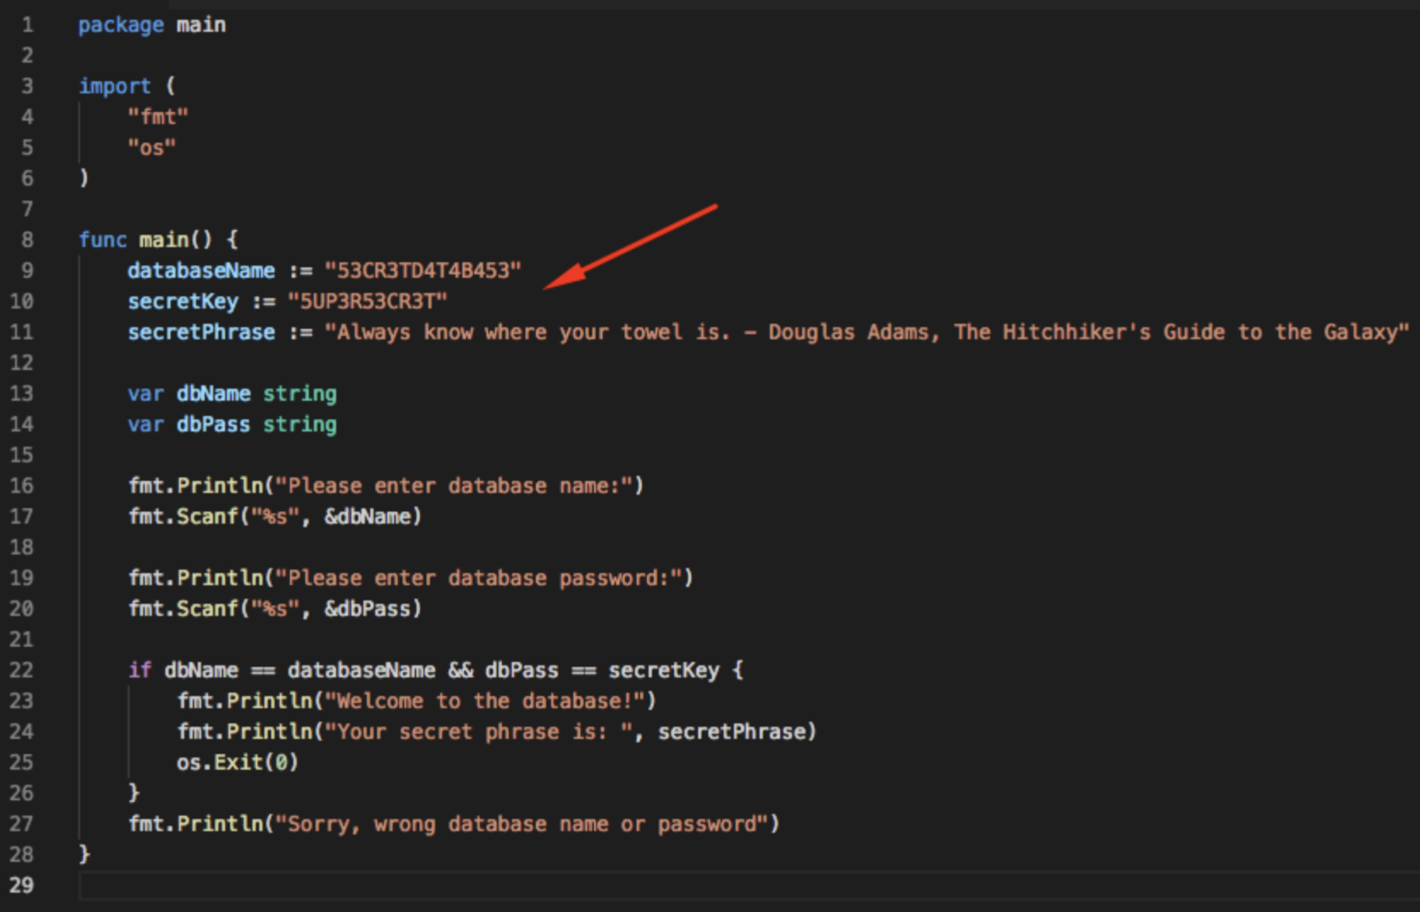

Slide 18

https://www.gitguardian.com/state-of-secrets-sprawl-report-2023

Slide 19
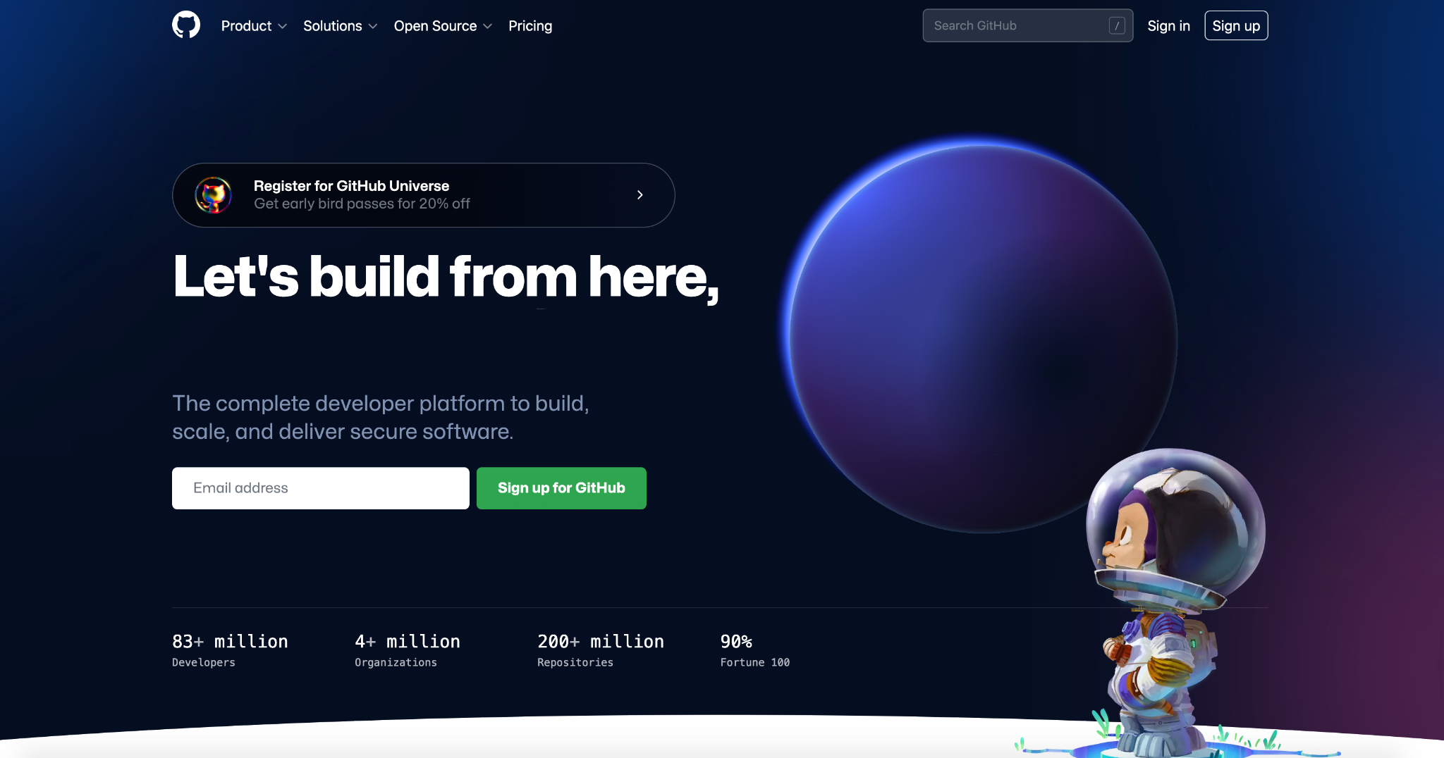
Demo

Slide 20
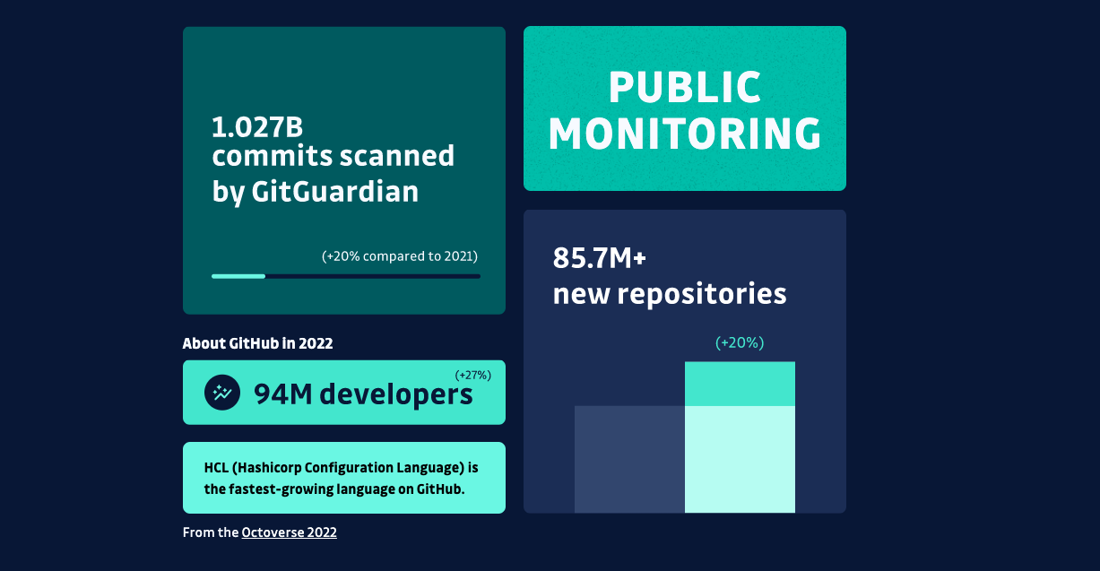

Slide 21
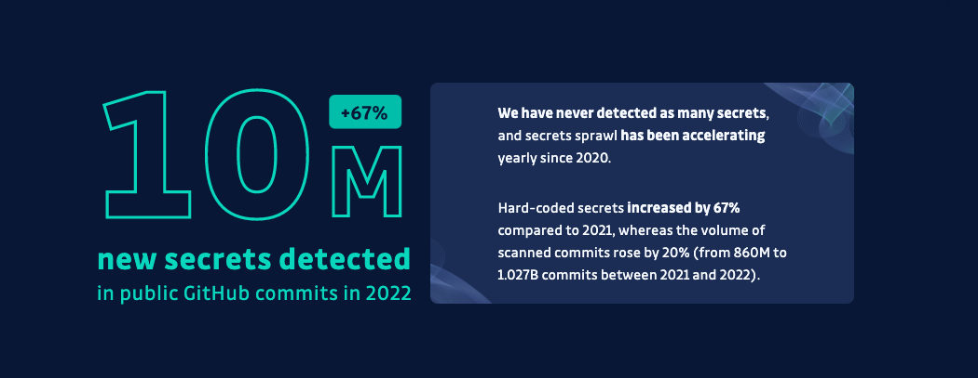

Slide 22
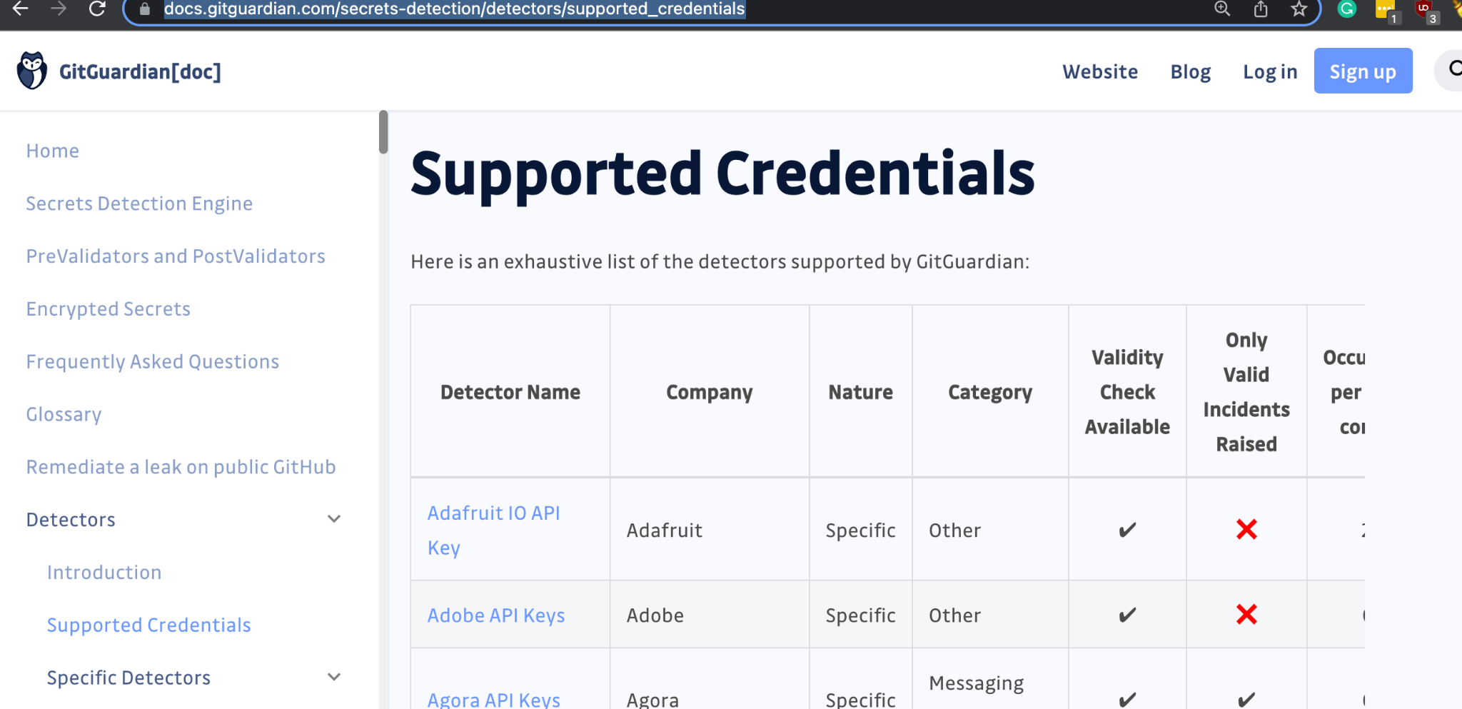
https://docs.gitguardian.com/secrets-detection/detectors/supported_credentials

Slide 23
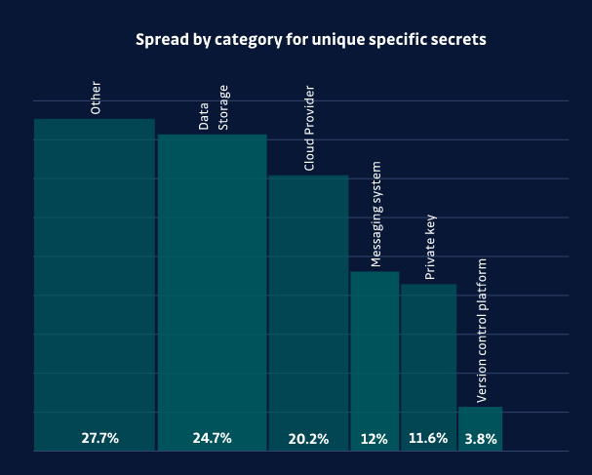

Slide 24
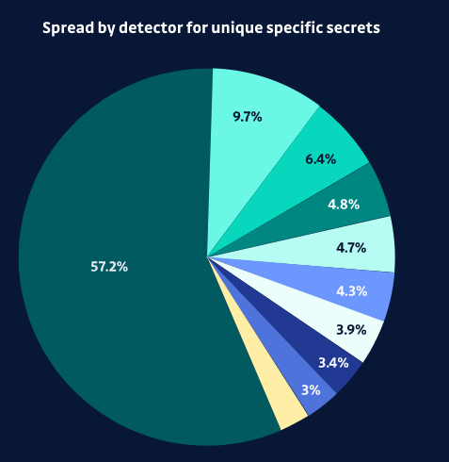
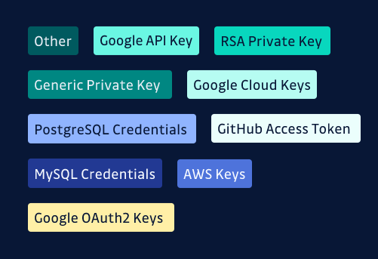

Slide 25
What Does This Mean For The Enterprise?
Notes:
Dev
DevOps
QA
Security

Slide 26
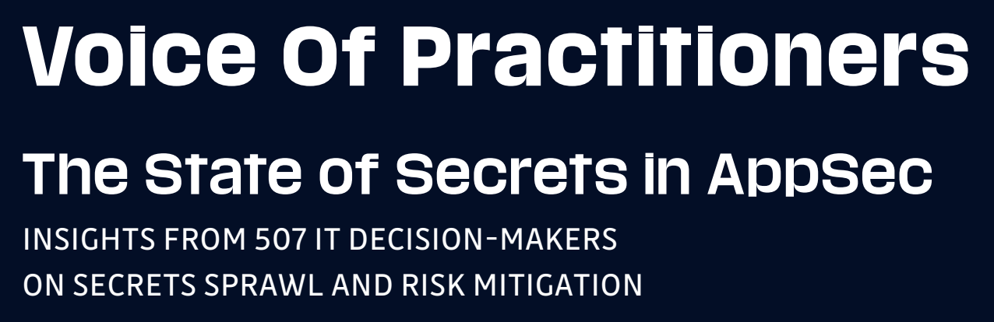
https://blog.gitguardian.com/voice-of-practitioners-the-state-of-secrets-in-appsec/

Slide 27
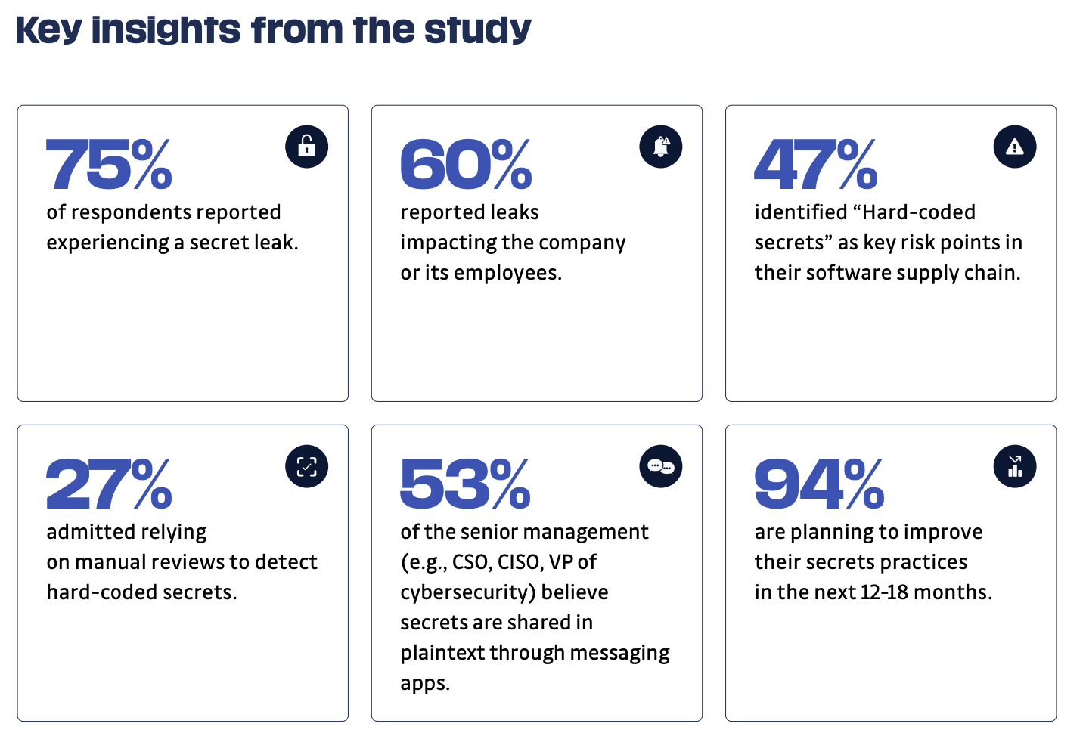

Slide 28
What Can I Do To Prepare Future Leaks?
Notes:
Dev
DevOps
QA
Security

Slide 29
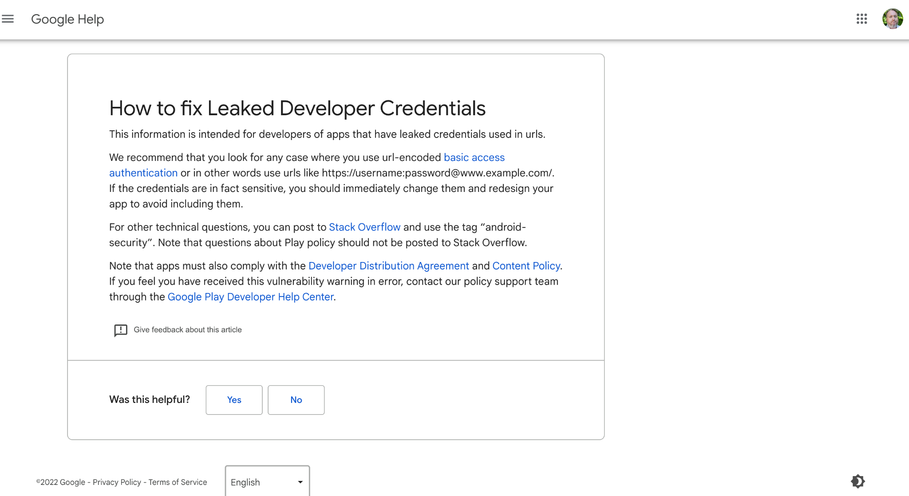
"We recommend that you look for any case where you use url-encoded basic access authentication. If the credentials are in fact sensitive, you should immediately change them and redesign your app to avoid including them. " – Google Help

Slide 30


Stop Hardcoding Secrets Use secrets managers like Hashicorp Vault or Azure Key Vault

Slide 31
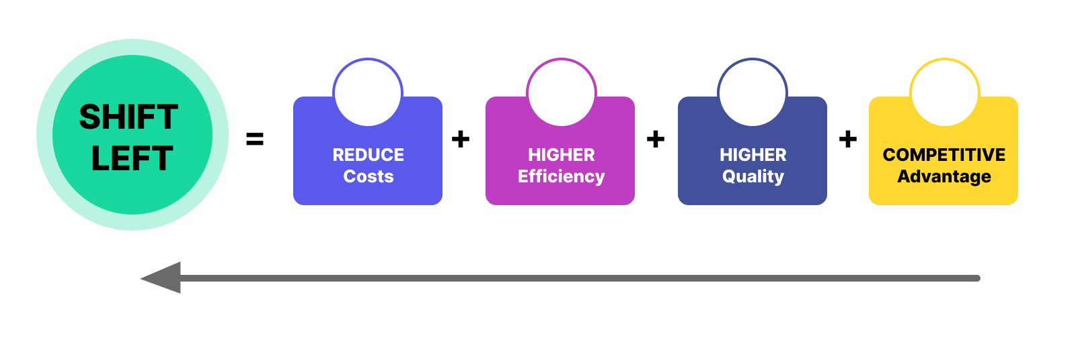
Notes:
https://www.amazon.sg/Mobile-Whiteboard-Magnetic-Double-Sided-Rolling/dp/B083NC6SPZ?th=1

Slide 32

Notes:
https://www.amazon.sg/Mobile-Whiteboard-Magnetic-Double-Sided-Rolling/dp/B083NC6SPZ?th=1

Slide 33
Three pillars of a secrets management program
People
Train devs to use the tools and follow the processes
Raise awareness around secrets sprawl and secure coding practices
Processes
Create clear processes for provisioning, manaaging, and rotating secrets
Automate detection and remediation
Tools
Document the steps to follow for incident remediation by devs
Use vaults, secrets managers and HMS to manage secrets

Slide 34
A pragmatic approach to
secrets management in the SDLC
Level 4 Expert
Secrets are scoped, stored and called from a vault
Detection is preventive and integrated into dev workflows.
Secrets are scoped, stored in a vault and shared using a secrets manager. Automated detection on shared repositories and final artifacts is continuous.
Level 3
Advanced
Level 2
Intermediate
Secrets are checked encrypted into repositories with decryption keys stored in a secure vault.
Secrets scanning and rotation are performed periodically.
Level 1
Beginners
Secrets are unencrypted at rest and shared across teams. Scanning for secrets is triggered manually at times,
Level 0
Uninitiated
No processes or tools for managing secrets – secrets sprawl in the SDLC.
No detection (and remediation) in place.

Slide 35
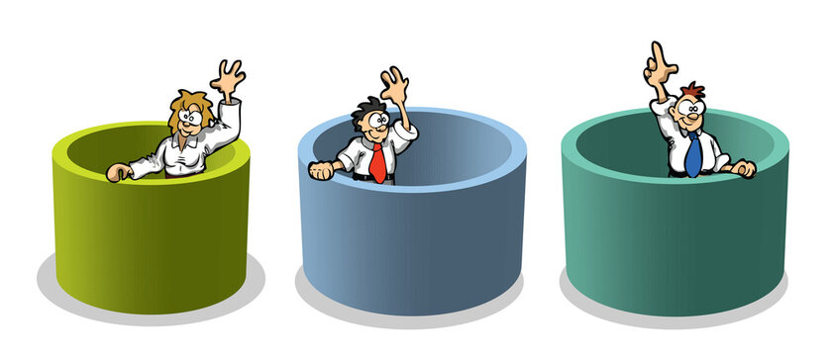

Slide 36
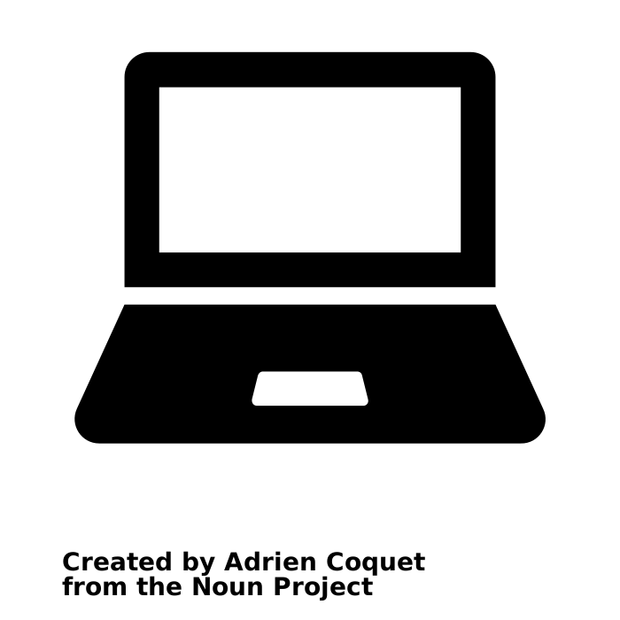
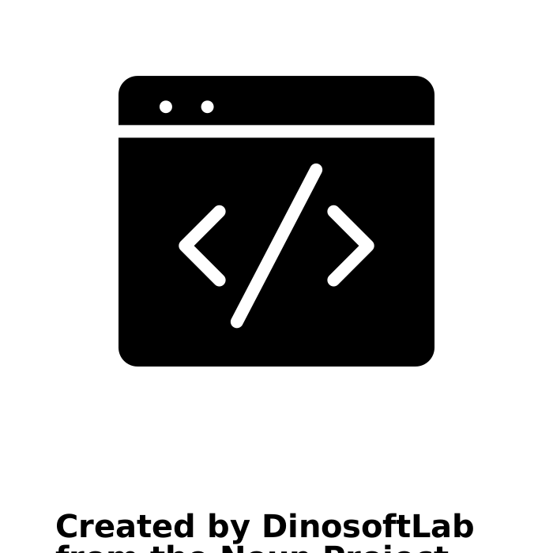


Level 0 – Uninitiated
High exposure risk
Secrets management
Secrets detection
Secrets are shared in clear text through private channels and stored unencrypted in local config files
No detection in place
Developer environments
Source Control
(Source code
& Infra-as-Code)
Secrets are unencrypted and checked into private repositories.
No detection in place
Secrets are embedded in artifacts
VCS and 3rd-party (e.g. code quality tools) access tokens are hardcoded in build scripts
No detection in place
CI/CD pipelines &
software artifacts
Secrets are embedded in scripts
Sensitive variables are printed in server logs
No detection in place
Runtime environments

Slide 37


Slide 38
Level 1 – Beginners
High exposure risk
Secrets management
Secrets detection
Secrets are unencrypted in config files but can be encrypted before sharing with other devs
No detection in place
Developer environments
Source Control
(Source code
& Infra-as-Code)
Secrets are grouped in config files and accessed using environment variables
IaC secrets are stored externally – by the cloud services provider (e.g. AWS, GCP)
Source code and IaC templates are scanned for secrets periodically
High-severity incidents are remediated with limited help from developers
Final artifacts do not contain any secrets
Pipeline secrets are stored in the build system
Build outputs (e.g. Docker images) are scanned for secrets manually before a release
CI/CD pipelines &
software artifacts
Secrets are grouped in a common config file
Sensitive variables are redacted from logs
Secrets are not scoped by environment
Secrets are rotated manually in case of exposure or compromise
Runtime environments

Slide 39


Slide 40
Level 2 – Intermediate
Moderate exposure risk
Secrets management
Secrets detection
Secrets are stored in a vault and shared through a secret manager
Developer environment secrets are correctly scoped
Scanning is triggered manually at times
Developer environments
Source Control
(Source code
& Infra-as-Code)
Secrets are encrypted and checked into repositories (master key is stored externally)
Critical repositories are continuously scanned at the pull/merge requests stage
Devs contribute to remediation but it is still not a well established and documented process
Secrets are stored in the build process
Secrets are scoped; permissions abide by the principle of least privilege
- Build outputs (e.g. Docker images) are scanned for secrets manually before a release
CI/CD pipelines &
software artifacts
Secrets (or master decryption key) are stored in a vault and dynamically loaded with a secrets manager with minimal access controls
Secrets are rotated manually in case of exposure or compromise
Runtime environments

Slide 41


Slide 42
Level 3 – Advanced
Low exposure risk
Secrets management
Secrets detection
Secrets are stored in a vault and shared exclusively through a secret manager
Secrets rotation policy is well defined
Scanning before pushing code (pre-commit / pre-push) is adopted by security champions
Developers are systematically involved in the remediation process
Developer environments
Source Control
(Source code
& Infra-as-Code)
Secrets are no longer embedded in the current source code revision
Secrets rotation policy is well defined
All repositories are continuously scanned for hardcoded credentials
Collaboration on incident remediation is mandatory for all developers
Pipeline secrets are stored in a vault and loaded using a secret manager
Secrets are scoped; permissions follow the principle of least privilege
Informative scanning is enforced for all branches (feature, hotfix, etc.) in CI pipelines
CI/CD pipelines &
software artifacts
Secrets are stored in a vault and dynamically loaded from a secrets manager
Secrets are scoped and access is monitored/logged
Secrets are scheduled for regular rotation
Runtime environments

Slide 43

Notes:
https://en.wikipedia.org/wiki/The_A-Team_(season_4)

Slide 44
Level 4 – Experts
Limited exposure risk
Secrets management
Secrets detection
Secrets are stored in a vault with access controls and logging
Dynamic secrets with limited scope are used for development when possible
Scanning before pushing code (pre-commit / pre-push) is adopted by all developers
Developers are systematically involved in the remediation process
Developer environments
Source Control
(Source code
& Infra-as-Code)
No presence of valid hardcoded secrets in past or current revisions of source code
All repositories are continuously monitored and blocking scans (pre-receive) are setup
Remediation workflows are automated and fixing is handled by developers
Pipeline secrets are short-lived, scoped, and stored in an external vault
If possible, build secrets are replaced by OpenID Connect (OIDC) tokens for auth.
Blocking scanning is enforced for all branches (feature, hotfix, etc.) in CI pipelines
CI/CD pipelines &
software artifacts
Secrets are stored in a vault and loaded dynamically from a secrets manager
Restrictive access controls and logging are enforced
Secrets are scheduled for regularly automated rotation
Runtime environments

Slide 45
In Conclusion

Slide 47
A pragmatic approach to
secrets management in the SDLC
Level 4 Expert
Secrets are scoped, stored and called from a vault
Detection is preventive and integrated into dev workflows.
Secrets are scoped, stored in a vault and shared using a secrets manager. Automated detection on shared repositories and final artifacts is continuous.
Level 3
Advanced
Level 2
Intermediate
Secrets are checked encrypted into repositories with decryption keys stored in a secure vault.
Secrets scanning and rotation are performed periodically.
Level 1
Beginners
Secrets are unencrypted at rest and shared across teams. Scanning for secrets is triggered manually at times,
Level 0
Uninitiated
No processes or tools for managing secrets – secrets sprawl in the SDLC.
No detection (and remediation) in place.

Slide 48
Notes:
https://en.wikipedia.org/wiki/The_A-Team_(season_4)

Slide 49
Hi, I’m Dwayne
I live in Chicago
Co Host - The Security Repo Podcast
I’ve been a Developer Advocate since 2016
On Twitter @mcdwayne
mcdwayne@mastodon.social
Happy to chat about anything, hit me up
Outside of tech, I love improv, karaoke and going to rock and roll shows!
Dwayne McDaniel

Slide 50
Do you know where your secrets are?
Exploring the problem of secret sprawl and secret management maturity

